Slide 1

Ismail Cem Bayramoglu​
Annette Martin​
Kunanon Chaojaroenrat​
Semen Petrov​

Slide 2
Define Success​
Absolute growth
ΔFollowers(since) = Followers(t) − Followers(t0)
Relative growth
Growth Rate(since) = (ΔFollowers(t) - Followers(t0)) / max(Followers(t0),1)
Audience size proxy
live_viewers_snapshot
Content performance proxy
vod_views_per_min
Consistency and activity
Videos_last_30d
days_active_30d
Avg_stream_duration_min
std_stream_duration_min

Slide 3
Stakeholders and Decisions
Streamer: chooses content/category and streaming schedule to maximize follower growth. Follower growth since first observation (ΔFollowers_since, GrowthRate_since).
Administrator: analyzes past performance and game trends, then recommends which games/categories and schedule changes are most likely to increase viewers and growth. Follower growth (primary), plus support indicators (live_viewers_snapshot, vod_views_per_min, activity/consistency proxies).
Moderator: moderation is discussed as a qualitative factor that may influence retention and growth, but it is not modeled as a measurable driver.
Sponsor: selects streamers to support based on measurable growth and engagement proxies (vod_views_per_min, live_viewers_snapshot, consistency/activity proxies).

Slide 4
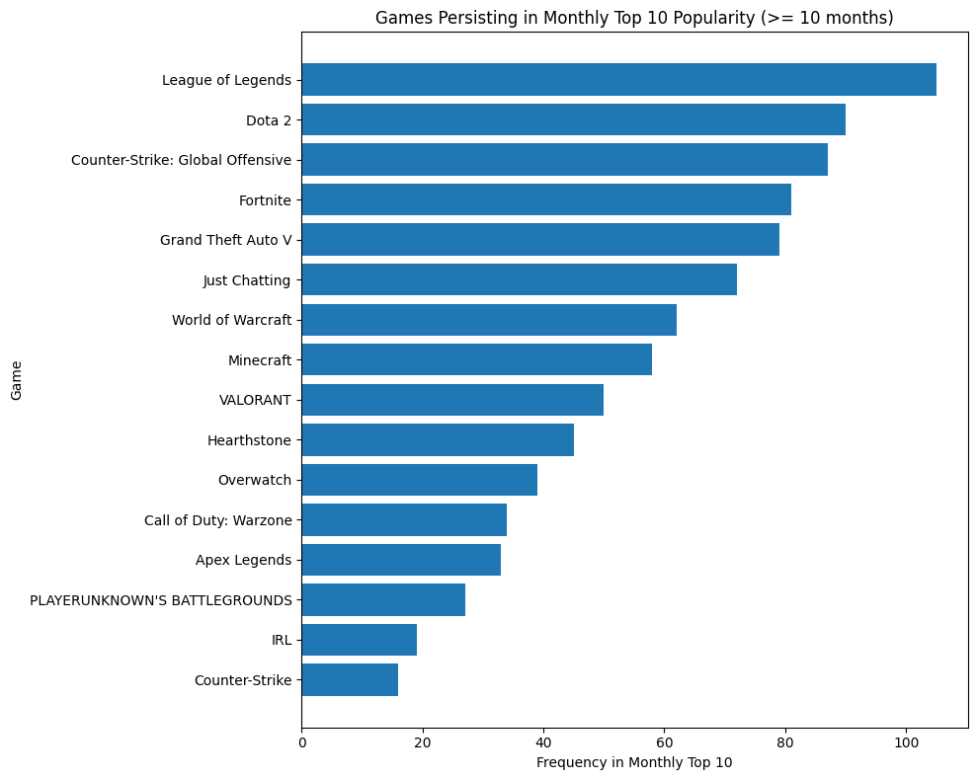
Kaggle Data

Slide 5
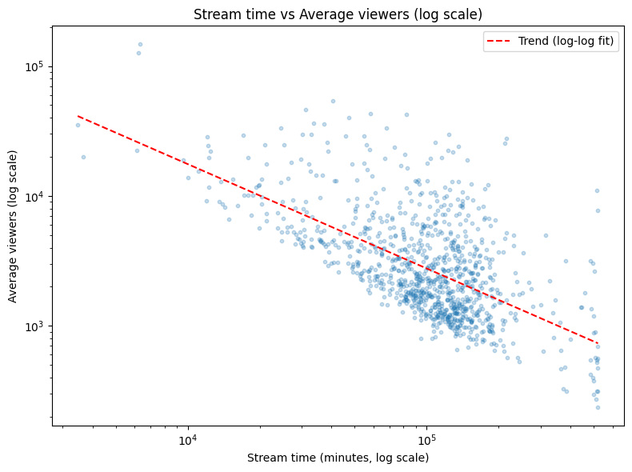
Kaggle Data
Negative association between total stream time and average viewers
Longer streaming is not automatically linked to higher viewership

Slide 6
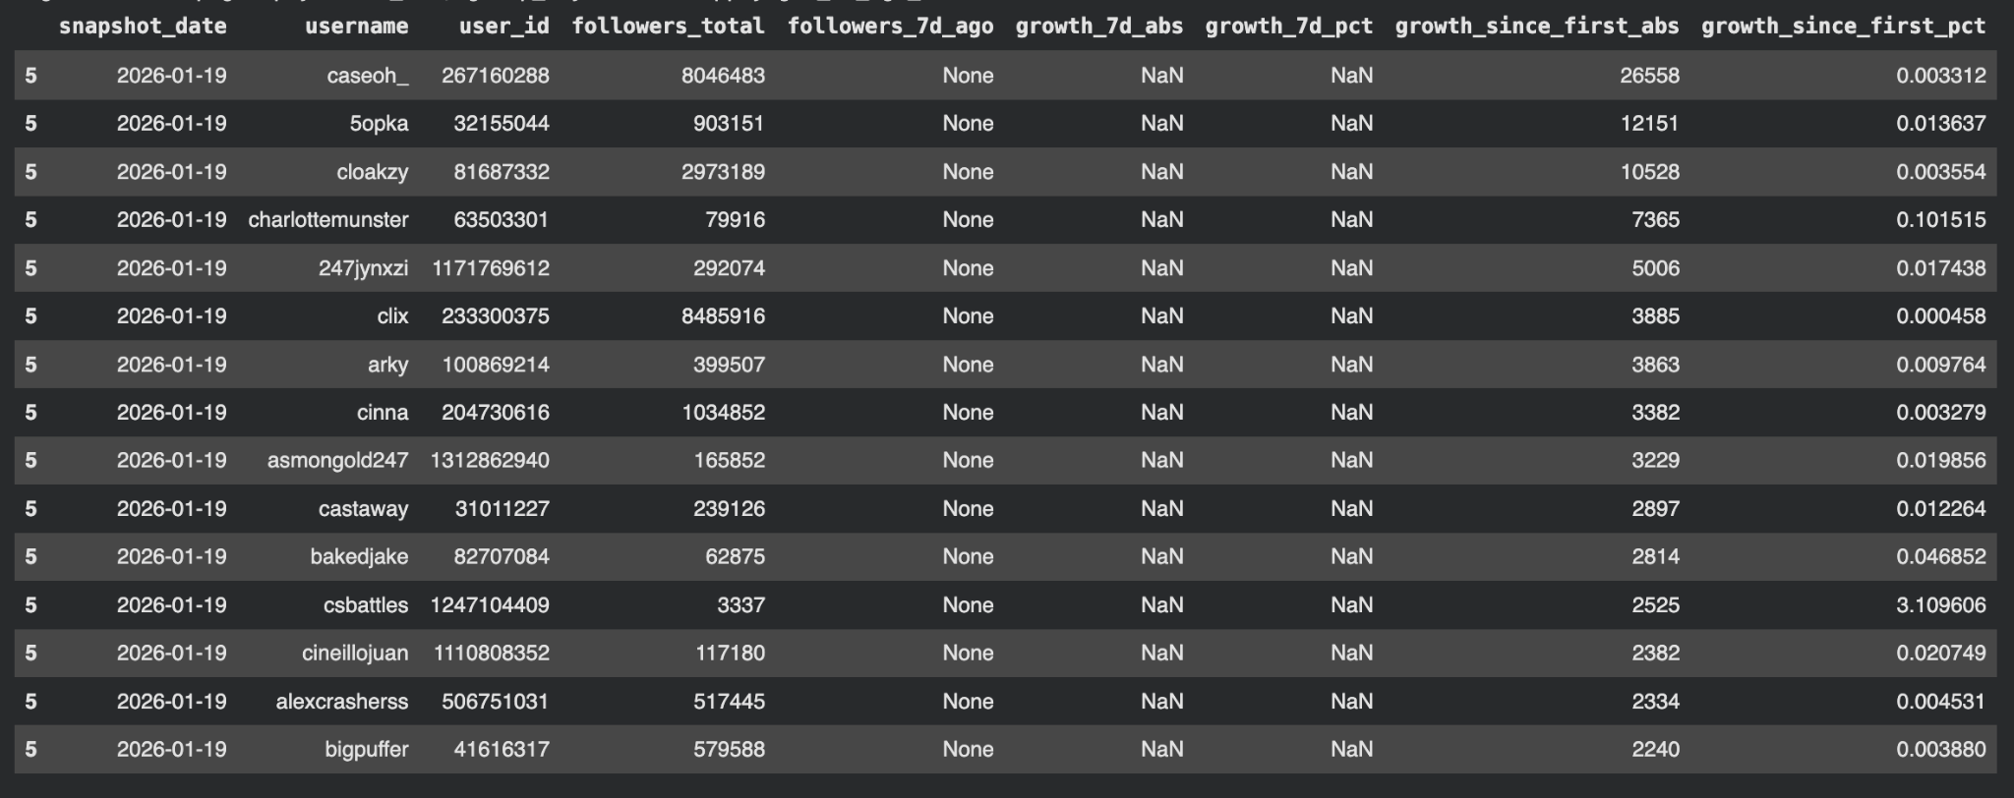
Twitch API Data

Slide 7
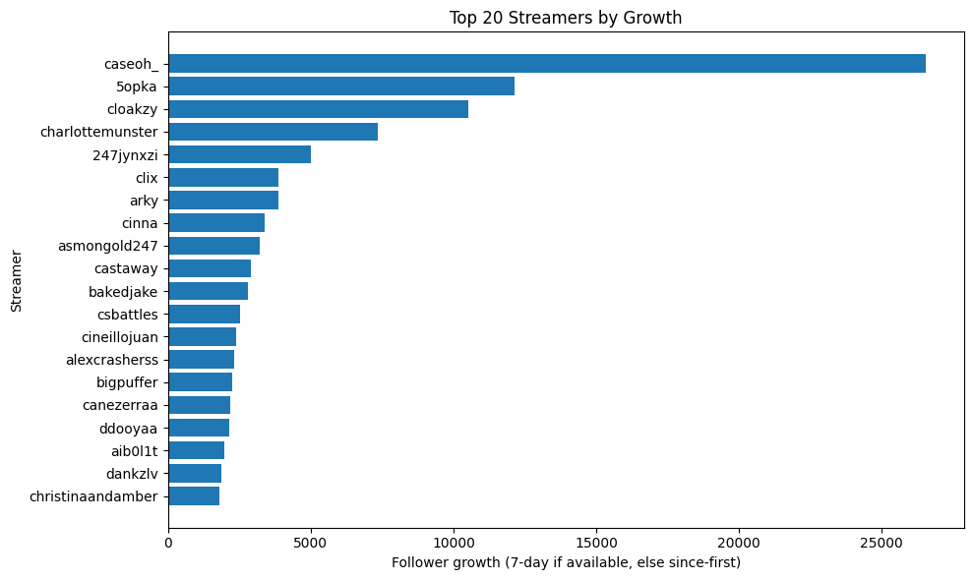

Slide 8
Correlations
Pearson Correlation
+1 = positive relationship
-1 = negative relationship
Linear Regression
β₁ = 500 for live_viewers_snapshot
positive coefficient = metric increases success
negative coefficient = metric decreases success
Standardization
standardized_value = (value - mean) / standard_deviation
R² Score
R² = 1.00 = Perfect prediction

Slide 9
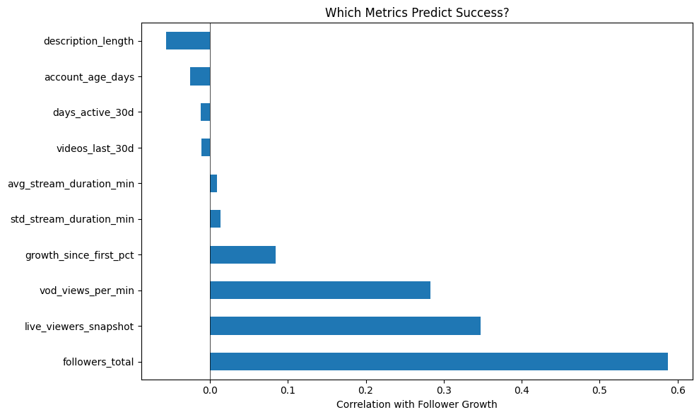

Slide 10
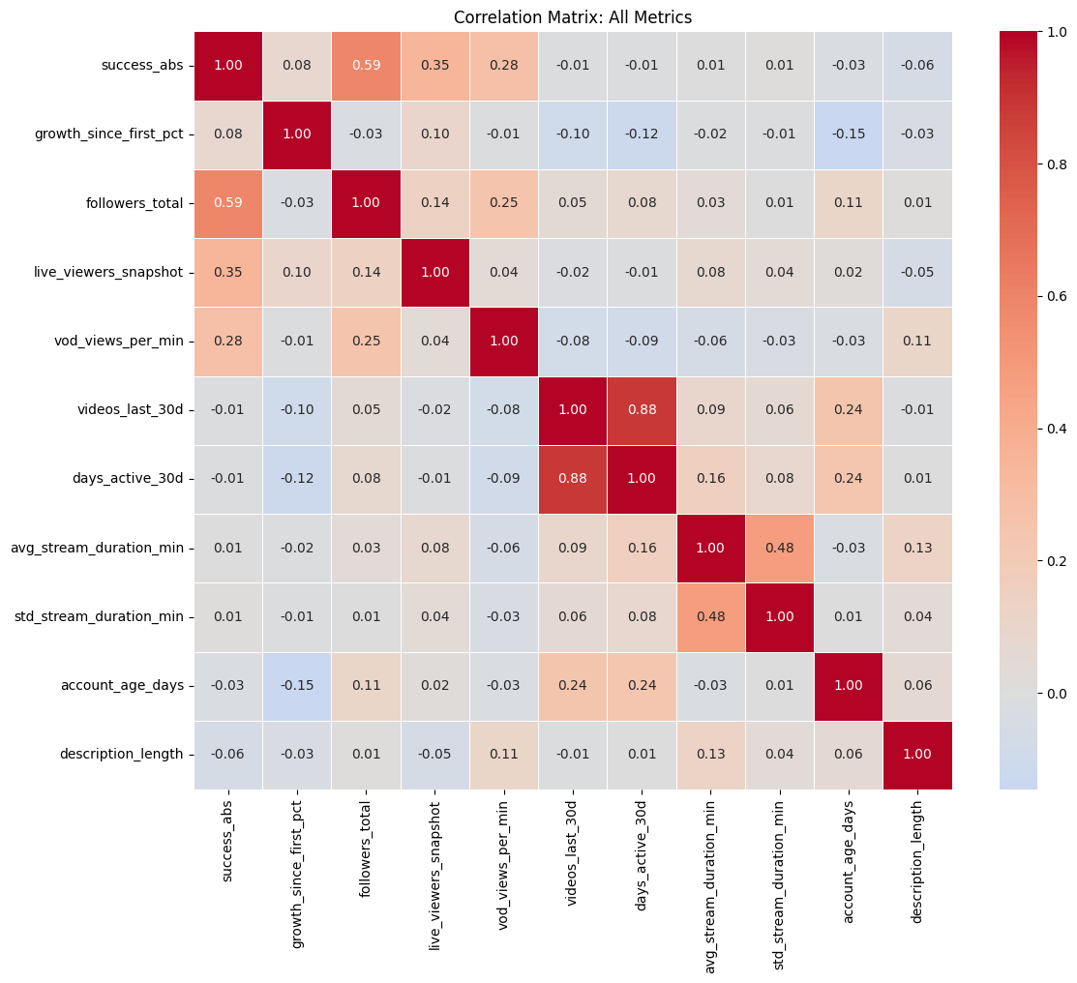

Slide 11
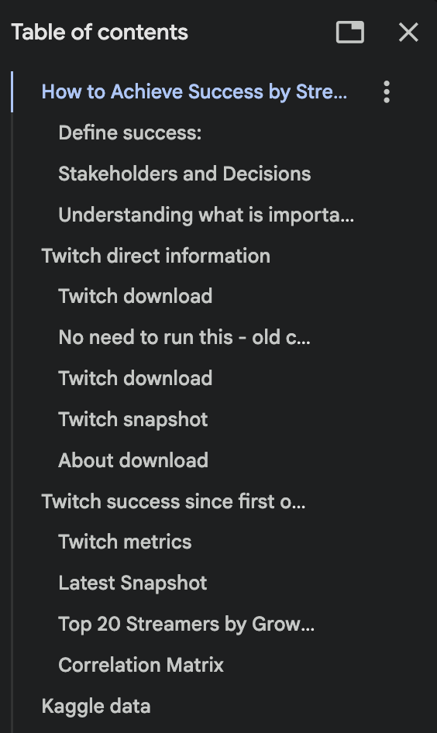
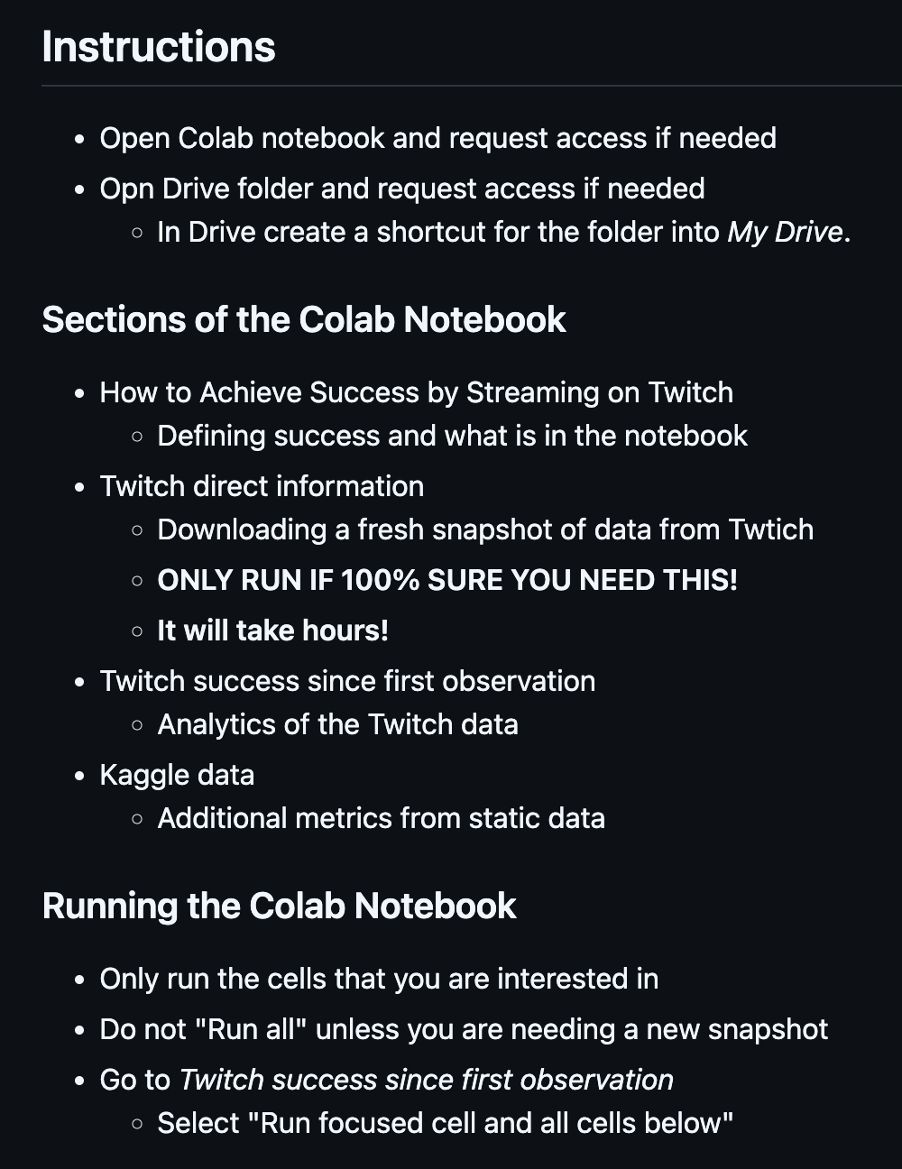
Colab & Github
Github

